Slide 1
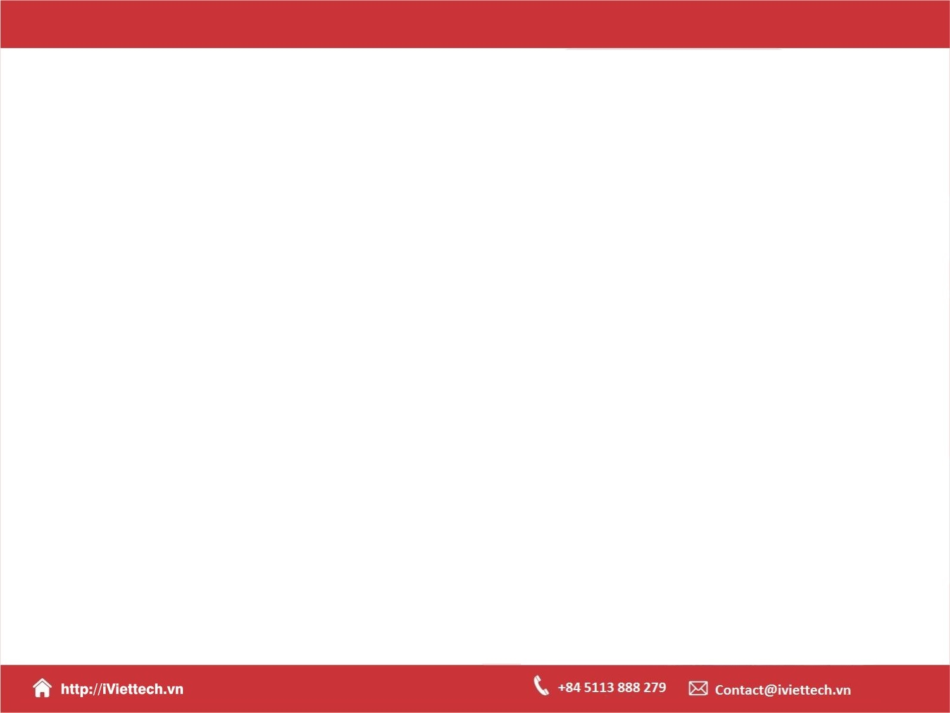
Chapter 8 Session 5 + 6
How to work with forms and data validation
Notes:
Session: Ghi số thứ tự session trong môn học
Session Name: ghi tên của session sẽ dạy

Slide 2
Objectives
Introduction to forms and controls
How to use jQuery to work with forms
A Validation application that uses JavaScript
How to use plugin for data validation
A Validation application that uses the validation plugin
Notes:
Mô tả nội dung mà học viên phải đạt được khi kết thúc môn học này

Slide 3
Introduction to forms and controls
Notes:
Session: Ghi số thứ tự session trong môn học
Session Name: ghi tên của session sẽ dạy

Slide 4
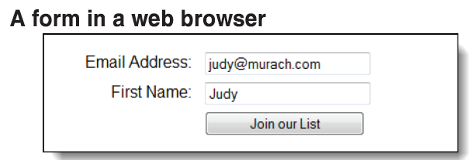
Introduction to forms
A forms contain one or more controls like text boxes, radio buttons, list and check boxes that can receive data.

Slide 5
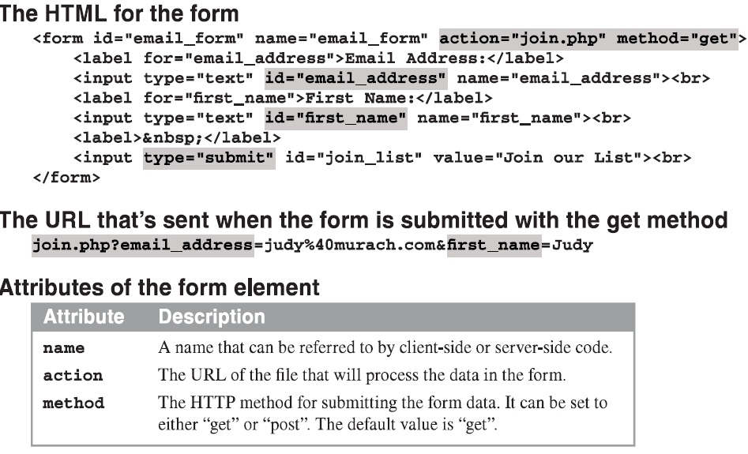
Introduction to forms (cont.)

Slide 6
Introduction to forms (cont.)
When you click on summit button for the form the form data is sent to the server as a part of an HTML request.
There are two method submit by data to the server are get and post.
The get method will show the data on the URL, with the post method, the data is hidden.
Data validation refers to checking the data collected by a form to make sure it is valid, and complete data validation is always done on the server.

Slide 7
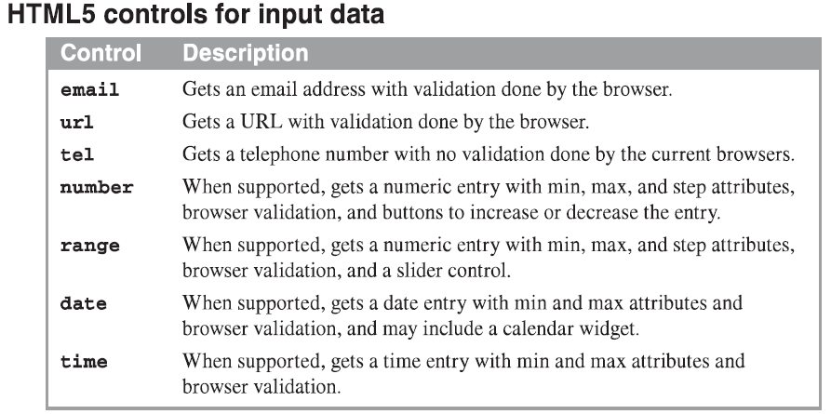
The HTML5 controls for working with forms

Slide 8
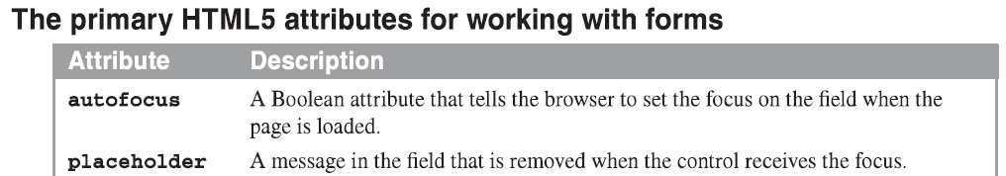
The HTML5 controls for working with forms (cont.)
Many of the HTML5 input controls provide for basic data validation.

Slide 9
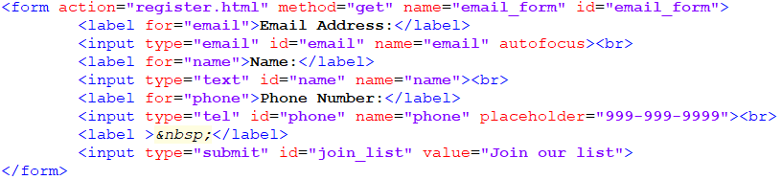
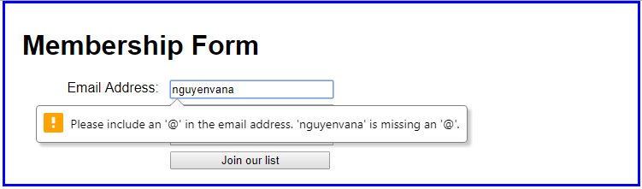
The HTML5 controls for working with forms (cont.)
The HTML for a form that uses some of these controls and attributes
The form with an error message for the email address

Slide 10
The HTML5 and CSS3 features for data validation
The HTML5 attributes for data validation
Attribute | Description
required | A Boolean attribute that indicates that a value is required for a field.
title | Text that is display in a tooltip when the mouse hover the field.
pattern | A regular expression that is used to validate the entry in a field.
novalidate | A Boolean attribute that tell the browser that it shoudn’t validate.
autocomplete | Set this attribute “off” to tell browser to disable auto-complete.

Slide 11
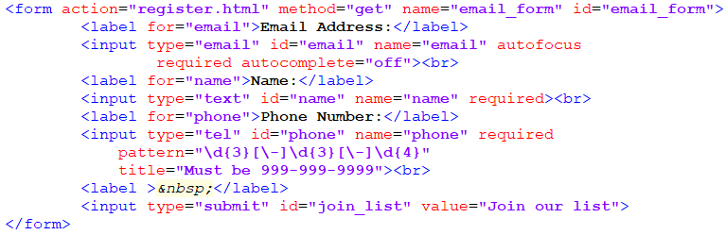
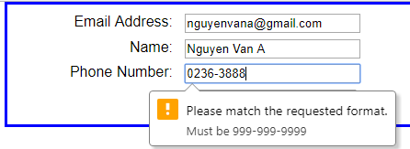
The HTML5 and CSS3 features for data validation (cont.)
The HTML for a form that uses some of these attributes
The form with an error message for the phone field

Slide 12
How to use jQuery to work with forms
Notes:
Session: Ghi số thứ tự session trong môn học
Session Name: ghi tên của session sẽ dạy

Slide 13
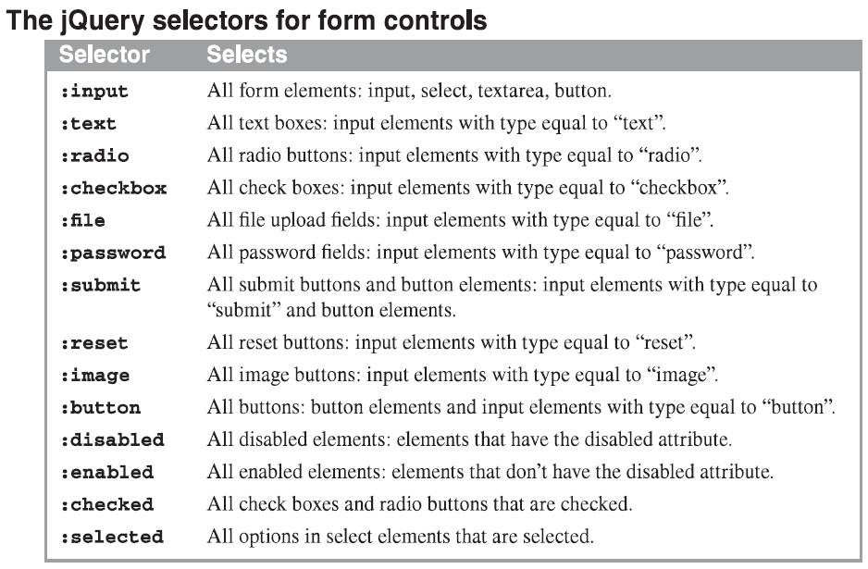
The jQuery selectors and methods for forms

Slide 14
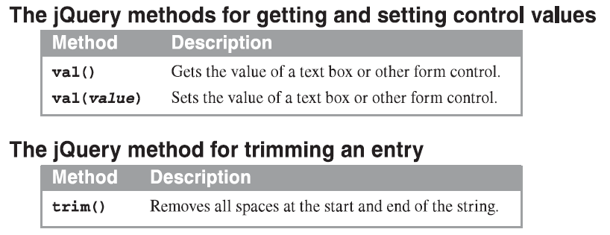
The jQuery selectors and methods for forms (cont.)

Slide 15
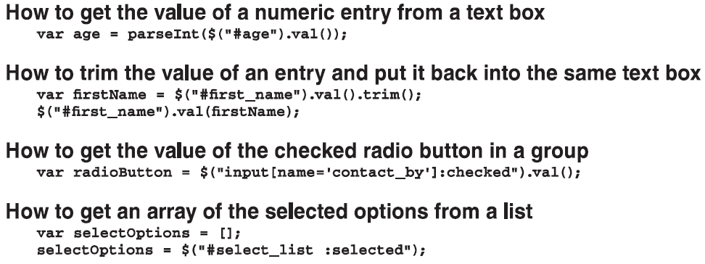
The jQuery selectors and methods for forms (cont.)

Slide 16
The jQuery event methods for forms
You can use event handlers for the focus, blur, change, and select events to process data as the user works with individual controls.
You can use event handler for the click event of a regular button to validate data in a form.
Also you can use an event for the submit button to validate data in a form. Then if any data is invalid, you can issue the preventDefault() method to cancel the submission of the data to the server.

Slide 17
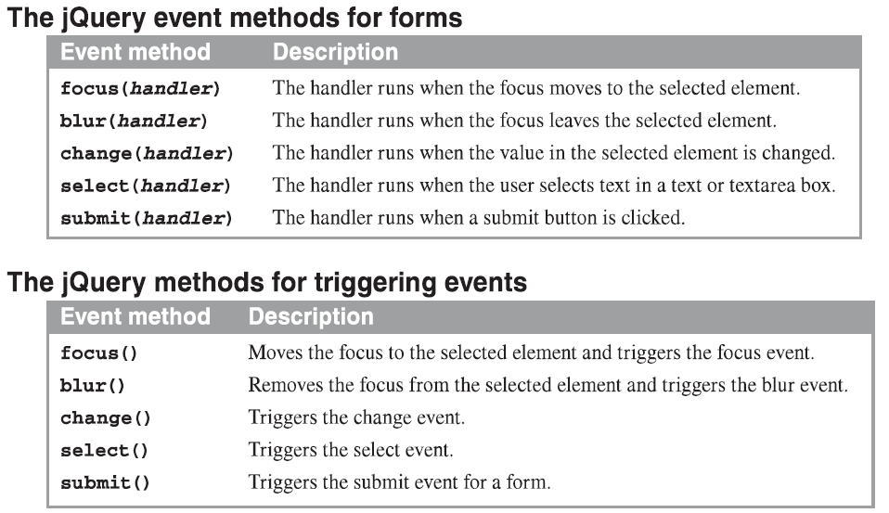
The jQuery event methods for forms (cont.)

Slide 18
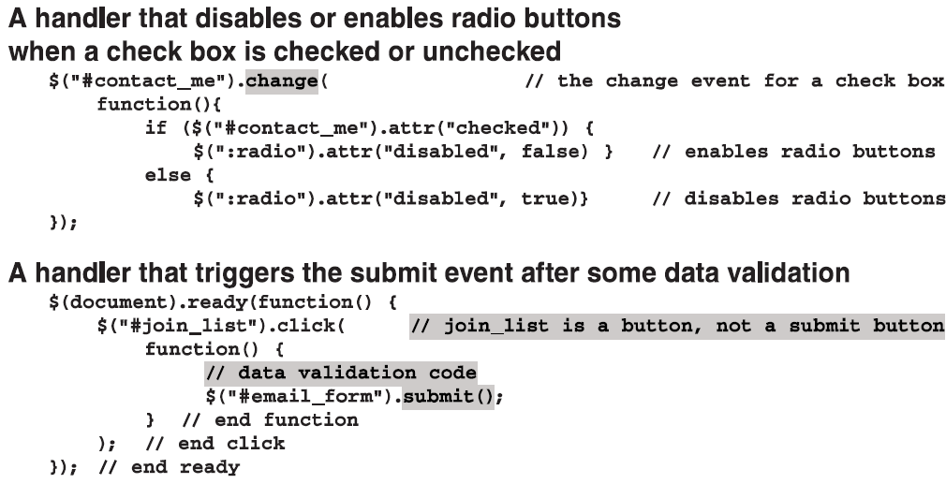
The jQuery event methods for forms (cont.)

Slide 19
A Validation application that uses JavaScript
Notes:
Session: Ghi số thứ tự session trong môn học
Session Name: ghi tên của session sẽ dạy

Slide 20
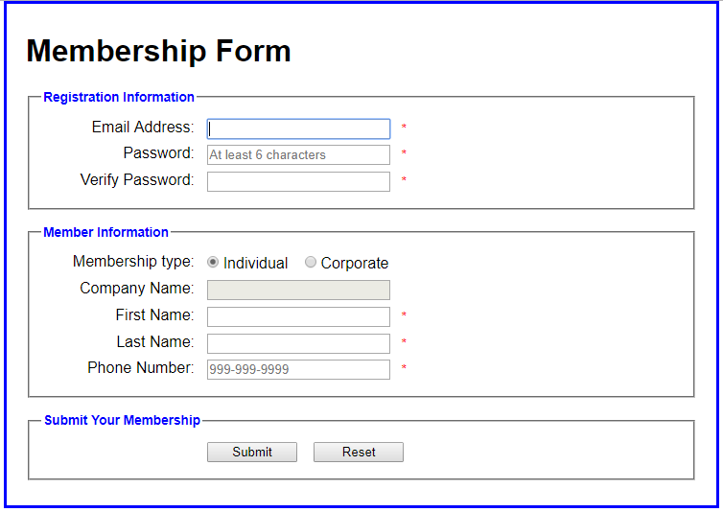
A Validation application
The web interface

Slide 21
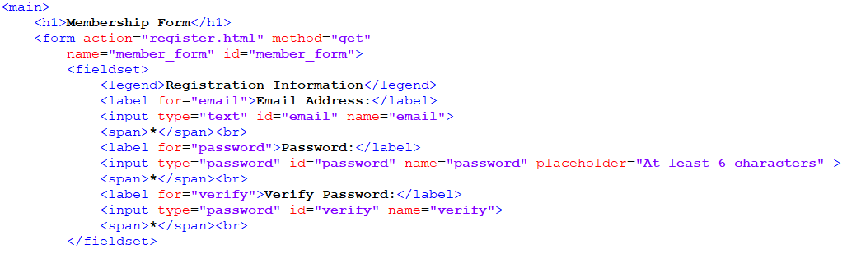
A Validation application (cont.)
The HTML code

Slide 22
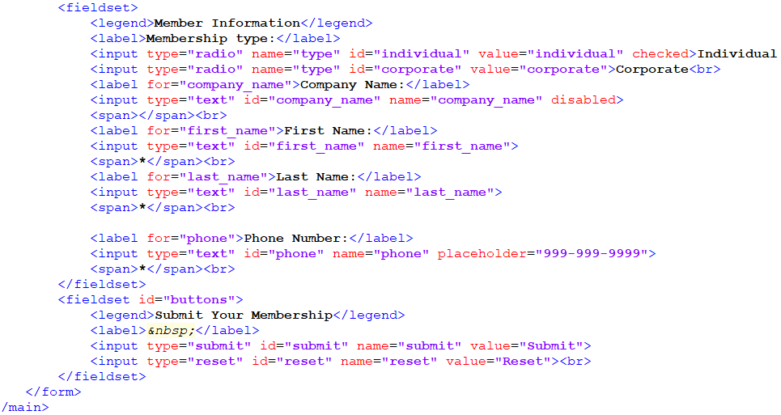
A Validation application (cont.)
The HTML code

Slide 23
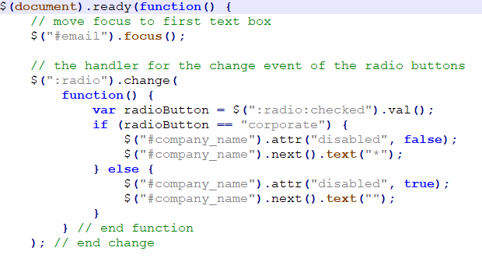
A Validation application (cont.)
The JavaScript code

Slide 24
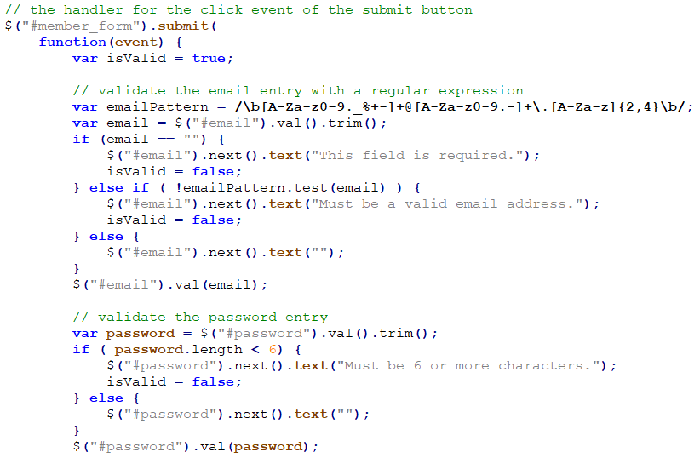
A Validation application (cont.)
The JavaScript code

Slide 25
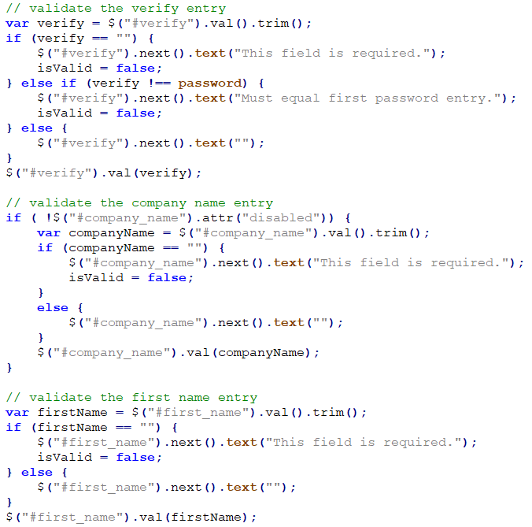
A Validation application
The JavaScript code

Slide 26
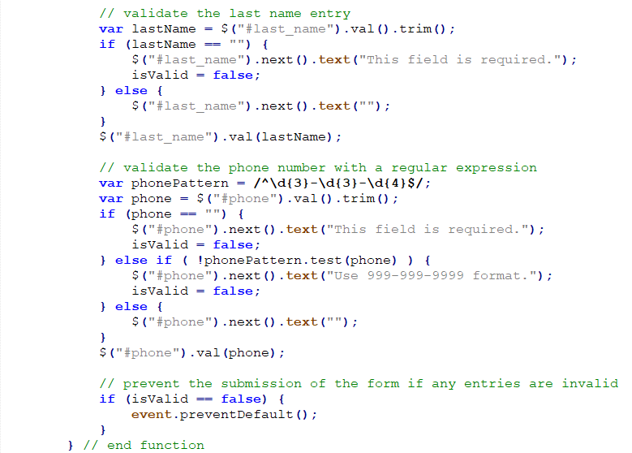
A Validation application (cont.)
The JavaScript code

Slide 27
How to use a plugin for data validation
Notes:
Session: Ghi số thứ tự session trong môn học
Session Name: ghi tên của session sẽ dạy

Slide 28
How to use plugin for data validation
The validation plugin was written and maintained by Jorn Zaefferer, a member of jQuery team and a lead developer of jQuery UI team.
The URL for validation plugin:
https://jqueryvalidation.org/

Slide 29
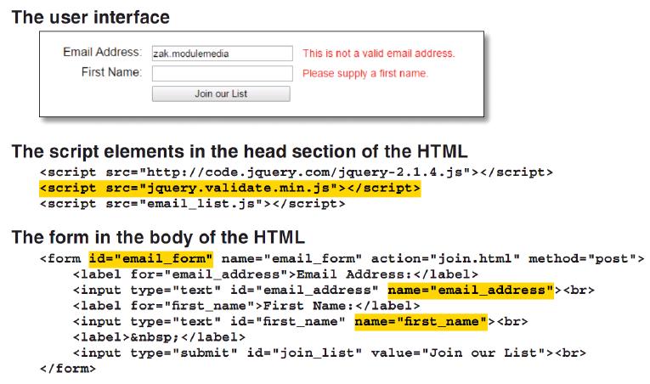
How to use plugin for data validation (cont.)

Slide 30
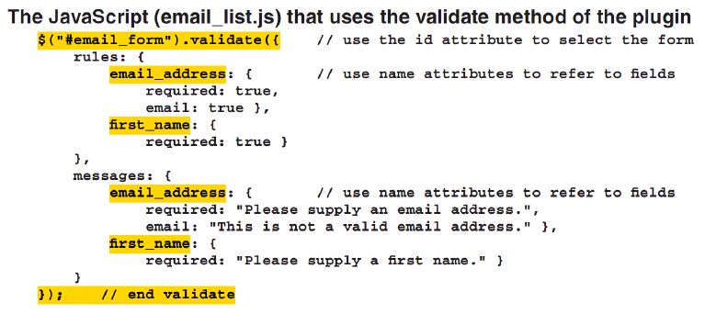
How to use plugin for data validation (cont.)

Slide 31
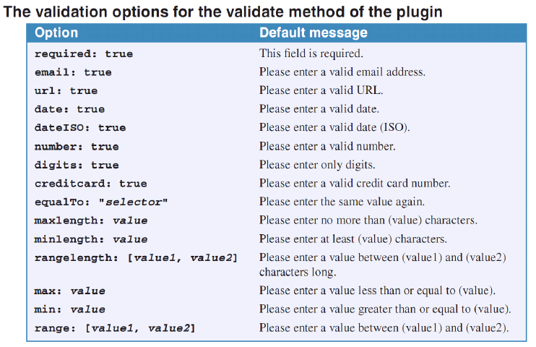
The option and default error messages for the validation plugin

Slide 32
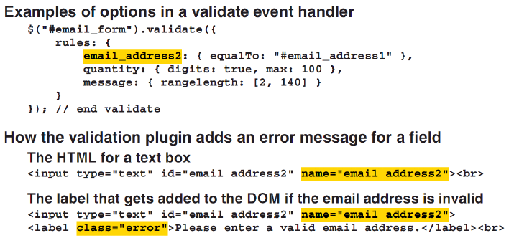
The option and default error messages for the validation plugin (cont.)

Slide 33
A Validation application that uses the validation plugin
(page 268-273)
Notes:
Session: Ghi số thứ tự session trong môn học
Session Name: ghi tên của session sẽ dạy

Slide 34
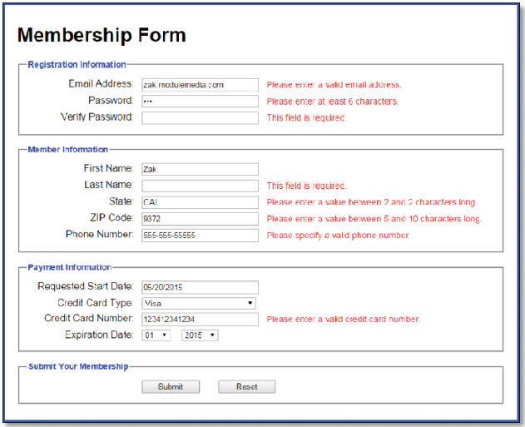
The interface of the Validation application

Slide 35
Summary
A forms contain one or more controls like text boxes, radio buttons, list and check boxes that can receive data.
When you click on summit button for the form the form data is sent to the server as a part of an HTML request.
The get method will show the data on the URL, with the post method, the data is hidden.
Data validation refers to checking the data collected by a form to make sure it is valid, and complete data validation is always done on the server.
Notes:
Tóm tắt lại nội dung đã học

Slide 36
Summary (cont.)
jQuery provides special selectors for selecting the controls on the form, the val() method for getting and setting the value in a control, and a trim() method for trimming an entry.
You can use event handlers for the focus, blur, change, and select events to process data as the user works with individual controls.
You can use event handler for the click event of a regular button to validate data in a form.
You can use validation plugin to validate data for your application.
Notes:
Tóm tắt lại nội dung đã học

Slide 37
The End.

